Slide 1
AI Academy
Final Study Case
Luis Fernando Acosta Soto

Slide 2
Summary
Energy consumption spikes cause the energy suppliers to have to buy energy from third party producers to meet an increased demand, as failure to do this might shut down operations due to overload, which decreases profitability, and increases operational headway, as power grid operators need to make manual adjustments.

Slide 3
Problem Statement
The ability to detect these anomalies automatically, instead of manually, will allow response protocols and downstream responses to become more efficient, by enabling auto-flagging of incidents across the grid.

Slide 4
Objective

Slide 5
Methodology
Develop and maintain a production-running classification model (champion-challenger selection) trained on anomaly historical data to classify upon-arrival any possible anomaly and be able to take downstream actions on it.
Sensitivity > 70%
Specificity > 90%
F1-score
Notes:
Tomar el accuracy
Mencionar el modelo con menor % de error Cuadrado
Explicar que es el F1-Score

Slide 6
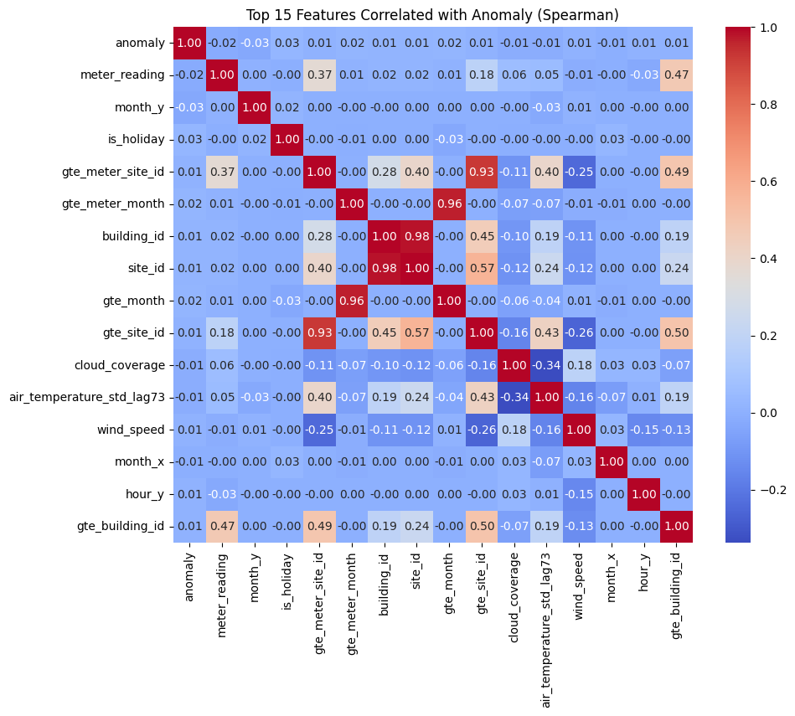
Experiments – Feature Selection
Correlation test (Spearman)
Notes:
Experimentar con quitar variables que se correlacionan mucho entre ellas
Explicar cuales fueron los pasos de preprocesamiento
Dedicar una slide para metodologia de preparacion de datos
Mencionar un modelo de datos con esquema medallion
Estar preparado para mostrar el script
el script es el entregable (debe ser un Proyecto continuable)
Approx 30 minutos incluyendo Q&A

Slide 7
Experiments – Features
Correlation test (Spearman)
Chi-square test (independence)

Slide 8
Results

Slide 9
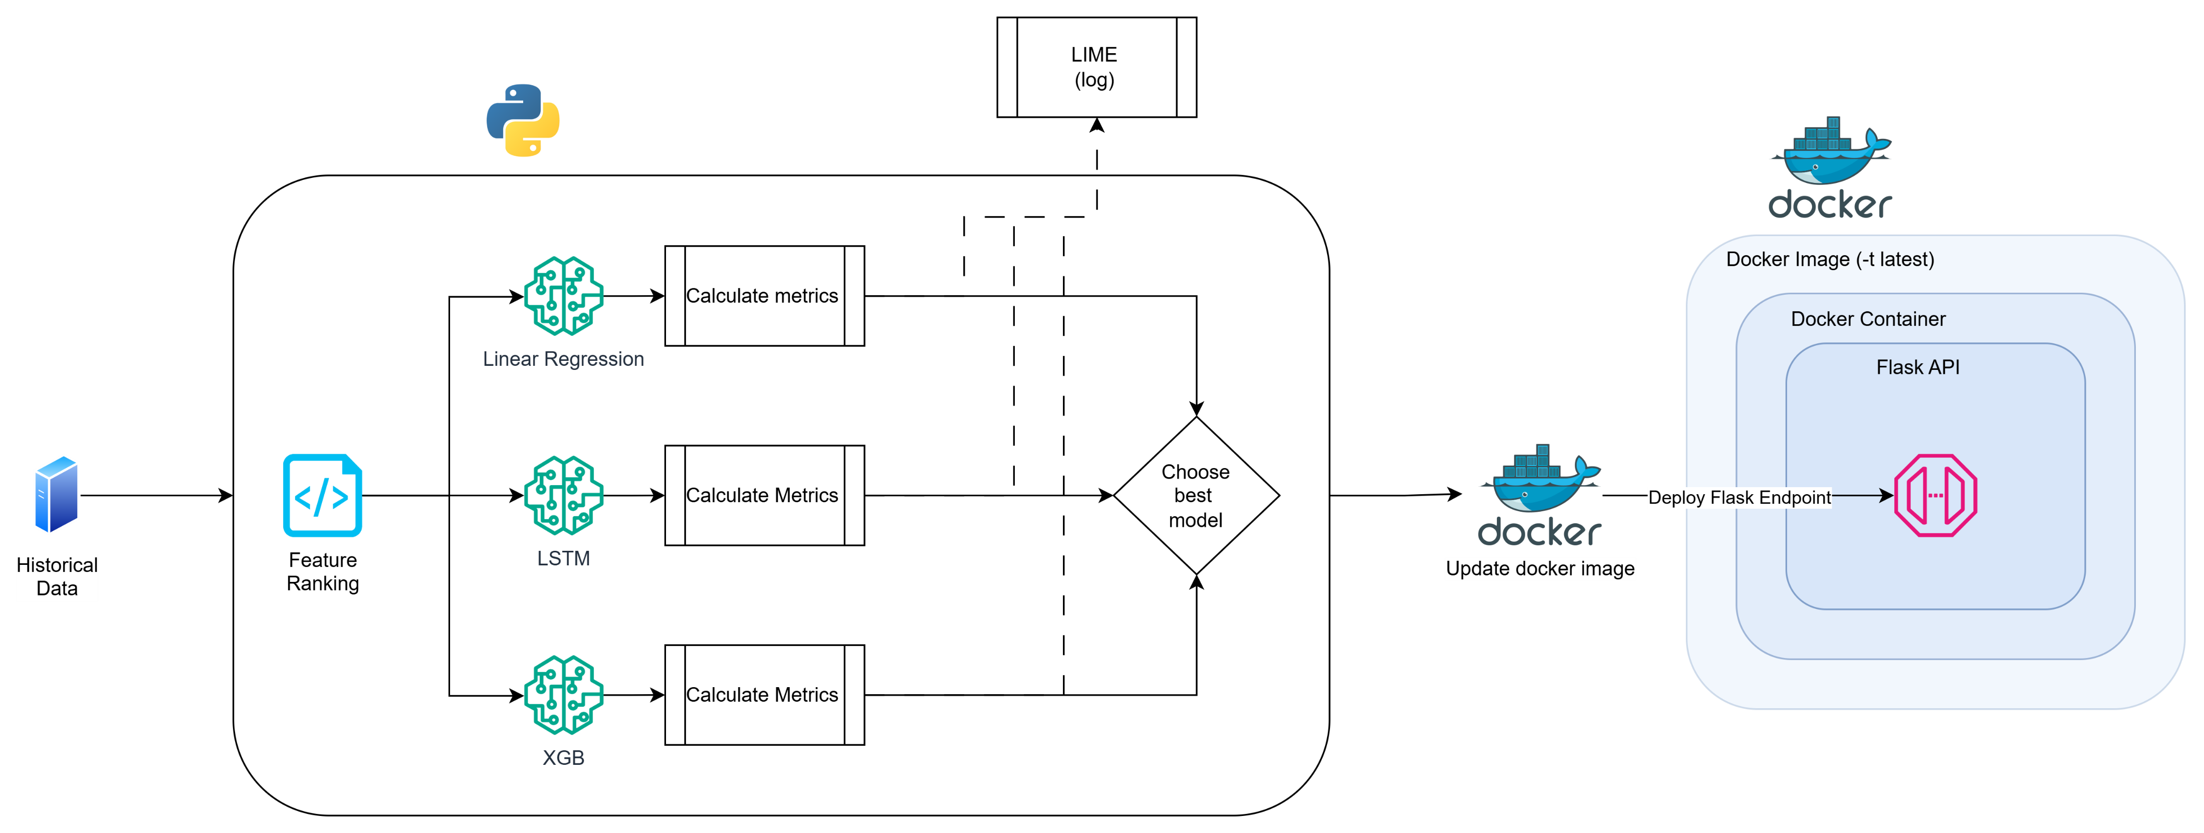
POC
Notes:
1 slide para revisar resultados de LIME
Incluir parte de data segmentation

Slide 10
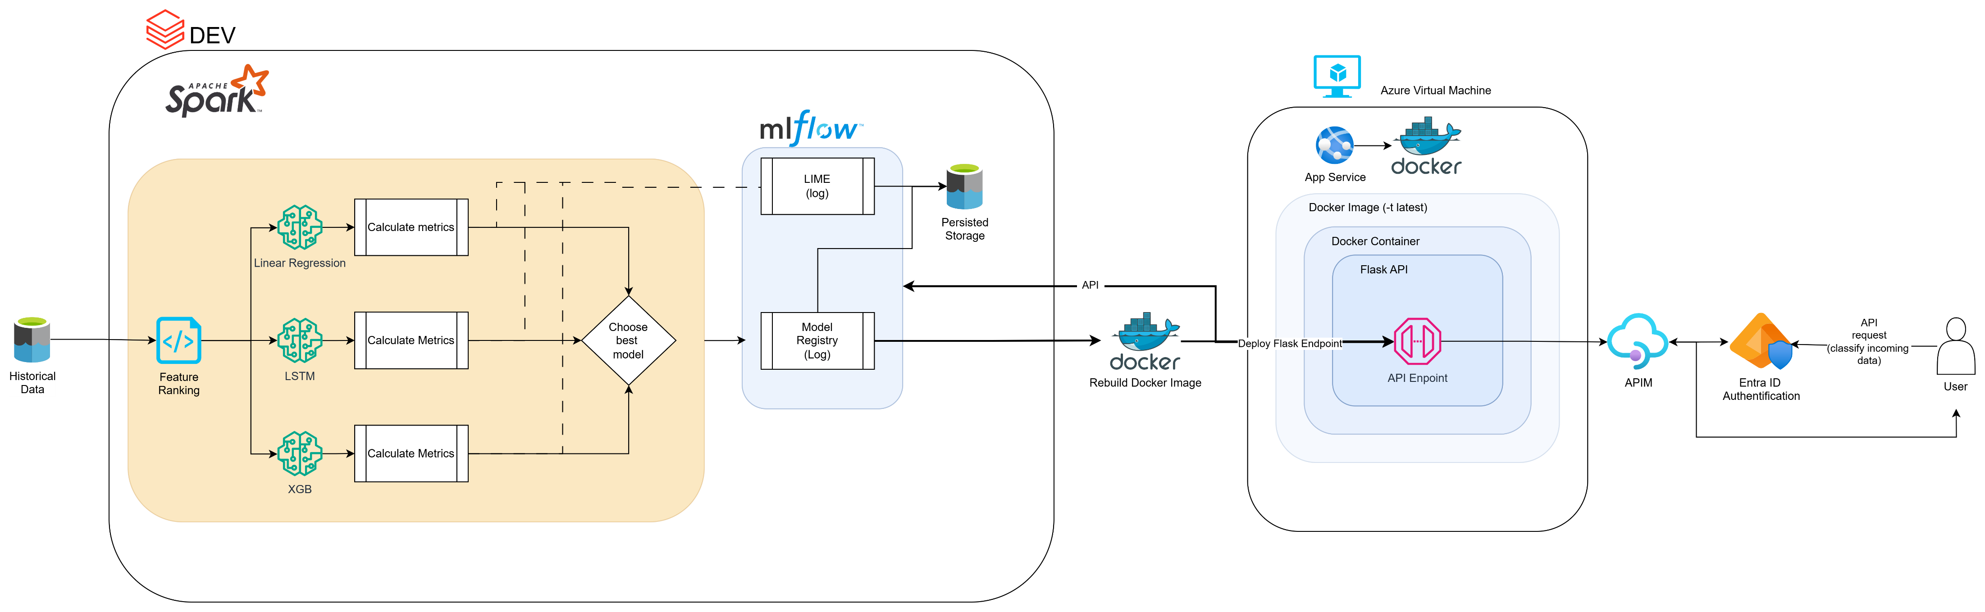
Next-steps

